Slide 1
面向中小学科学教育大模型的领域知识增强方法研究与实现
汇报人：时子延
指导教师：周俊生老师
成员：董文杰 马艺轩
2024.12.19
Notes:
Good afternoon ladies and gentlemen. It's a pleasure to be here with you today. My talk today will deal primarily with Adaptive Long-Short Pattern Transformer for Stock Investment Selection.

Slide 2
项目实施情况总结
01
项目已有成果
02
目录
成果展示
03
04
后续计划
04
05
Notes:
First of all, I'll be presenting the background of Stock Investment Selection. Then, I'll introduce our methods and experiments. Finally, I'll make a conclusion of the work.

Slide 3
项目实施情况总结
前期工作
课题调研，信息检索
参与K12数据集构建
基于文本知识库的RAG
相关技术栈学习
最小可用产品实现（MVP）
现阶段成果
基于知识图谱（KG）的RAG
改进Naïve RAG的框架
Faiss 信息检索
构建K12领域的基准测试
研究与创新
PDFdata to KG 自动化脚本
原始检索增强生成框架（Naïve RAG）的优化
以知识图谱子图为检索单位进行信息检索
构建基准测试评估模型
TechEdu KG
Advanced RAG
Faiss on KG Subgraphs
Benchmark
Notes:
Now let’s turn to the first part of my talk, background. Different from the general time series modeling, it is difficult to assess stock’s evolving trend confronting with highly volatile and interrelated natures of the market. Also, the synergy [ˈsɪnədʒi] effect is another prominent trait of stock market. This effect means that related stocks are apt to exhibit synchronous [ˈsɪŋkrənəs] changes. However, Previous works mostly treat individual stocks as isolated and some studies just resort to limited domain knowledge which may lead to information bias.

Slide 4
阶段性成果
List：
科学教育领域知识图谱自动化构建与可追溯化可解释性的知识路径分析 —— TechEdu KG
原始检索增强生成框架的三个核心模块：提取模块、检索模块、增强模块—— Naïve RAG
实现原始检索增强生成框架的优化 —— Advanced RAG
提出以知识图谱子图作为检索单位的检索方法 —— Faiss on KG Subgraphs
构建科学教育领域基准测试 —— Benchmark
Notes:
In the early research on the Stock Investment Selection, the traditional machine learning methods use machine learning algorithms based on manual indicators. As a result, The hypothetical stochastic process may become stranded in catching non-stationary oscillations. In recent years, deep neural networks have shown encouraging prospects in characterizing stock dynamics, especially the RNNs are the dominant choice. However, they are ineffective to learn the dependencies of long-range discontinuous temporal states. As an alternative, the well-known Transformer can perform information exchange between input tokens to fix the deficiencies of RNN.

Slide 5
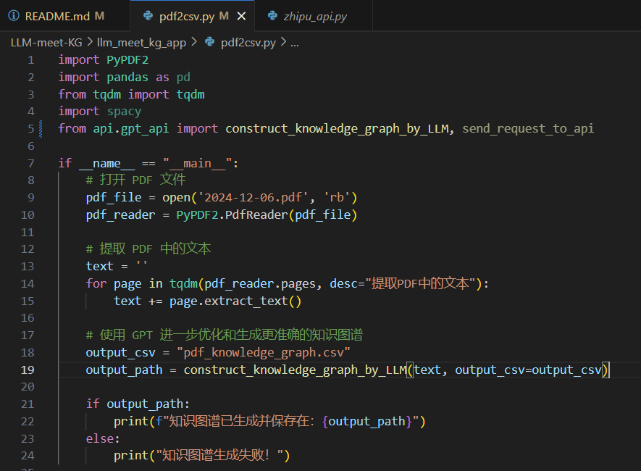
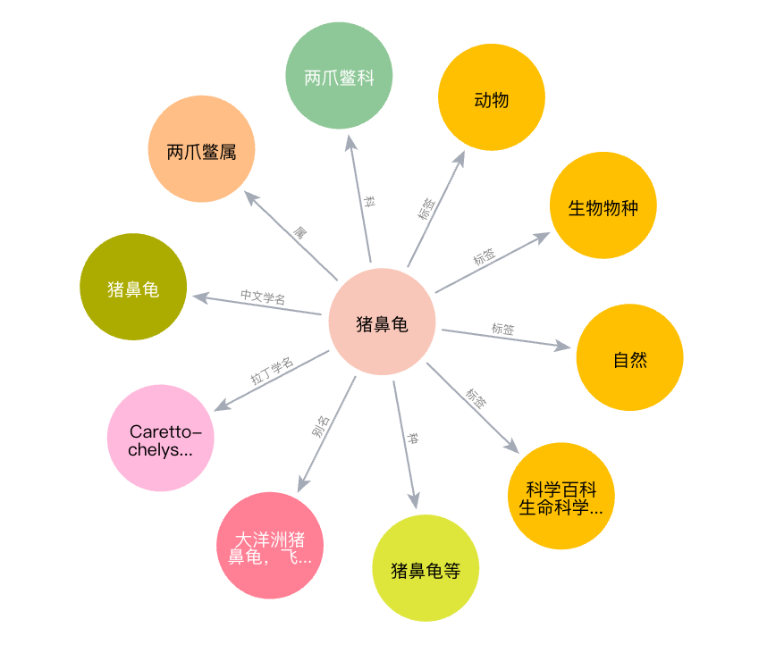
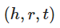

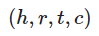
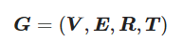
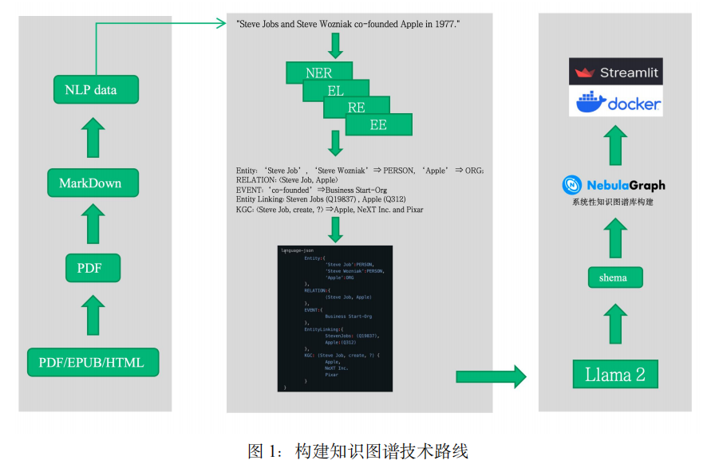
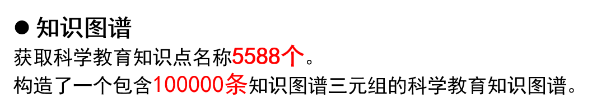
成果展示：TechEdu KG
Notes:
Now let’s turn to the first part of my talk, background. Different from the general time series modeling, it is difficult to assess stock’s evolving trend confronting with highly volatile and interrelated natures of the market. Also, the synergy [ˈsɪnədʒi] effect is another prominent trait of stock market. This effect means that related stocks are apt to exhibit synchronous [ˈsɪŋkrənəs] changes. However, Previous works mostly treat individual stocks as isolated and some studies just resort to limited domain knowledge which may lead to information bias.

Slide 6
成果展示—TechEdu KG
知识图谱构建
课本PDF数据
将课本PDF数据转化为markdown文本
NLP data
Model-based Sentence Segmentation（Bert）
将中文翻译为英文以提高IE准确度
BERT + IE 构建三元组的生成脚本
知识图谱三元组
GLM-4+Prompt 自动提取高质量三元组
T5-based Triple Extraction Model
Notes:
Now let’s turn to the first part of my talk, background. Different from the general time series modeling, it is difficult to assess stock’s evolving trend confronting with highly volatile and interrelated natures of the market. Also, the synergy [ˈsɪnədʒi] effect is another prominent trait of stock market. This effect means that related stocks are apt to exhibit synchronous [ˈsɪŋkrənəs] changes. However, Previous works mostly treat individual stocks as isolated and some studies just resort to limited domain knowledge which may lead to information bias.

Slide 7

成果展示—TechEdu KG
知识图谱可溯化与路径分析
增加元数据（如sentence.id）保证
边集（relation）可溯性
知识图谱三元组
知识图谱四元组
shortestPath
多跳路径
路径查询
Neo4j
Notes:
Now let’s turn to the first part of my talk, background. Different from the general time series modeling, it is difficult to assess stock’s evolving trend confronting with highly volatile and interrelated natures of the market. Also, the synergy [ˈsɪnədʒi] effect is another prominent trait of stock market. This effect means that related stocks are apt to exhibit synchronous [ˈsɪŋkrənəs] changes. However, Previous works mostly treat individual stocks as isolated and some studies just resort to limited domain knowledge which may lead to information bias.

Slide 8
成果展示：Advanced RAG
原因与背景
原始检索增强生成框架（Naïve RAG）不足以应对复杂提问
复杂提问一般具有历史连续，内容冗余等特点，容易导致LLM产生知识性幻觉。
通过重写用户请求模块，增加内容提取模块，事实验证模块实现原始检索增强生成框架的优化—Advanced RAG
Notes:
Now let’s turn to the first part of my talk, background. Different from the general time series modeling, it is difficult to assess stock’s evolving trend confronting with highly volatile and interrelated natures of the market. Also, the synergy [ˈsɪnədʒi] effect is another prominent trait of stock market. This effect means that related stocks are apt to exhibit synchronous [ˈsɪŋkrənəs] changes. However, Previous works mostly treat individual stocks as isolated and some studies just resort to limited domain knowledge which may lead to information bias.

Slide 9
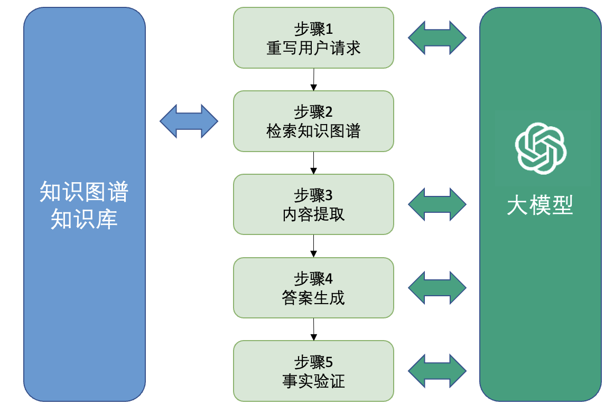
成果展示--Advanced RAG
Advanced RAG
Notes:
However, directly applying Transformer to modeling stock movements is problematic in two aspects. Firstly, the global self-attention focuses on point-wise token similarities without contextual insights. So the lack of pattern-wise interaction hinders the adequate discrimination of stock tendency and is susceptible to noise points. Secondly, the basic query-key matching paradigm is position agnostic. For example, in this figure, {A;B} reflects stock wave patterns in the context of long-term spans and {C;D} reflects short-term spans. The patterns C and D are closer than A and B, which means that their interaction is more responsible for observing high-frequency regularities. This inspires us to factor in the elapsed time between stock change patterns.

Slide 10
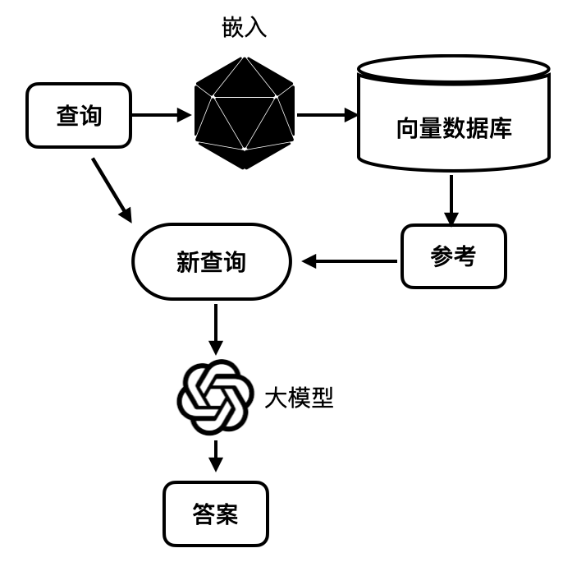
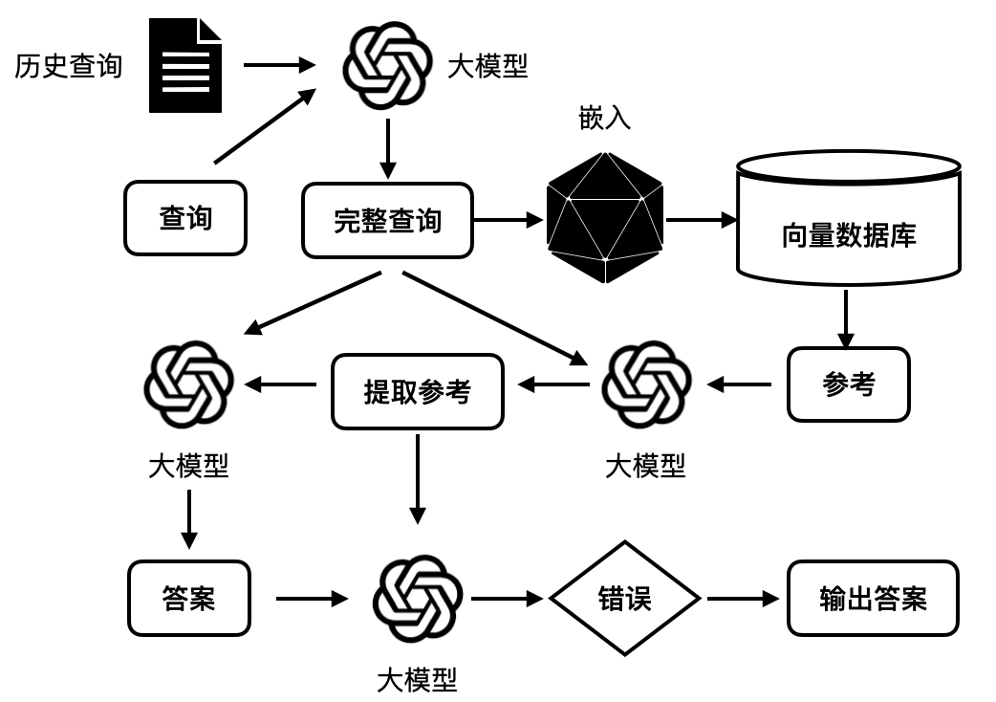
成果展示--Advanced RAG
流程对比
Naïve RAG
Advanced RAG
Notes:
However, directly applying Transformer to modeling stock movements is problematic in two aspects. Firstly, the global self-attention focuses on point-wise token similarities without contextual insights. So the lack of pattern-wise interaction hinders the adequate discrimination of stock tendency and is susceptible to noise points. Secondly, the basic query-key matching paradigm is position agnostic. For example, in this figure, {A;B} reflects stock wave patterns in the context of long-term spans and {C;D} reflects short-term spans. The patterns C and D are closer than A and B, which means that their interaction is more responsible for observing high-frequency regularities. This inspires us to factor in the elapsed time between stock change patterns.

Slide 11
成果展示--Advanced RAG
用户请求模块
重写原因：
提问是连续的，用户的当前提问并不一定完整，而是包含着潜在的上文寓意。
构造了合理的prompt，将历史提问与当前提问共同输入进大模型中，得到重写后的用户请求。
表1 重写输入输出结果
输入 | 输出
history：介绍一下光的折射 request：那光的反射呢？ | 介绍一下光的反射
Notes:
However, directly applying Transformer to modeling stock movements is problematic in two aspects. Firstly, the global self-attention focuses on point-wise token similarities without contextual insights. So the lack of pattern-wise interaction hinders the adequate discrimination of stock tendency and is susceptible to noise points. Secondly, the basic query-key matching paradigm is position agnostic. For example, in this figure, {A;B} reflects stock wave patterns in the context of long-term spans and {C;D} reflects short-term spans. The patterns C and D are closer than A and B, which means that their interaction is more responsible for observing high-frequency regularities. This inspires us to factor in the elapsed time between stock change patterns.

Slide 12
成果展示--Advanced RAG
内容提取模块
原因：
检索结果可能包含与用户查询无关的内容，对大模型造成干扰
大模型的输入长度限制
直接截断文档可能会丢失信息
构造滑动窗口检索内容提取器
检索结果：
['反丁烯二酸 中文名 反丁烯二酸', '反丁烯二酸 外文名 Fumaric acid', '反丁烯二酸 分子式 C4H4O4', '反丁烯二酸 分子量 116.07']
表2 背景内容提取的输入输出结果
输入 | 输出
request：介绍一下反丁烯二酸 | ['反丁烯二酸 中文名 反丁烯二酸', '反丁烯二酸 外文名 Fumaric acid', '反丁烯二酸 分子式 C4H4O4', '反丁烯二酸 分子量 116.07']
request：介绍一下乙烯 | No
Notes:
However, directly applying Transformer to modeling stock movements is problematic in two aspects. Firstly, the global self-attention focuses on point-wise token similarities without contextual insights. So the lack of pattern-wise interaction hinders the adequate discrimination of stock tendency and is susceptible to noise points. Secondly, the basic query-key matching paradigm is position agnostic. For example, in this figure, {A;B} reflects stock wave patterns in the context of long-term spans and {C;D} reflects short-term spans. The patterns C and D are closer than A and B, which means that their interaction is more responsible for observing high-frequency regularities. This inspires us to factor in the elapsed time between stock change patterns.

Slide 13
成果展示--Advanced RAG
答案生成模块
表3 答案生成的输入输出结果
输入 | 输出
content：['五氧化二磷 描述 五氧化二磷（phosphorus pentoxide），化学式P2O5。'] ['五氧化二磷 熔点 340℃' '五氧化二磷 沸点 360°C (升华)' ] request：五氧化二磷是什么？ | 五氧化二磷是一种无机化合物，化学式为P2O5，它的熔点时340℃，沸点是360℃。
Notes:
However, directly applying Transformer to modeling stock movements is problematic in two aspects. Firstly, the global self-attention focuses on point-wise token similarities without contextual insights. So the lack of pattern-wise interaction hinders the adequate discrimination of stock tendency and is susceptible to noise points. Secondly, the basic query-key matching paradigm is position agnostic. For example, in this figure, {A;B} reflects stock wave patterns in the context of long-term spans and {C;D} reflects short-term spans. The patterns C and D are closer than A and B, which means that their interaction is more responsible for observing high-frequency regularities. This inspires us to factor in the elapsed time between stock change patterns.

Slide 14
成果展示--Advanced RAG
事实验证模块
原因：
尽管提供了额外的背景知识来生成，但是大模型可能也会产生幻觉。
设计一个模块来进行进一步的事实验证
将参考背景文本和生成的答案提供给大模型进行判断是否包含事实错误。
背景文本：
1.光敏电阻 中文名 光敏电阻
2.光敏电阻 外文名 photoresistor"
3.光敏电阻 又称 光敏电阻器或光导管
4.光敏电阻 制作材料 硫化镉、硒、硫化铝、硫化铅和硫化铋
表4 事实验证的输入输出结果
输入 | 输出
answer：光敏电阻（photoresistor）是一种光敏元件，也称为光敏电阻器或光导管，常用的制作材料包括硫化镉、硒、硫化铝、硫化铅和硫化铋等材料。 | 否
answer：光敏电阻（photoresistor）是一种将检测到的气体的成分和浓度转换为电信号的传感器，它是利用某些半导体吸收某种气体后发生氧化还原反应制成的，主要成分是金属氧化物。 | 是
Notes:
However, directly applying Transformer to modeling stock movements is problematic in two aspects. Firstly, the global self-attention focuses on point-wise token similarities without contextual insights. So the lack of pattern-wise interaction hinders the adequate discrimination of stock tendency and is susceptible to noise points. Secondly, the basic query-key matching paradigm is position agnostic. For example, in this figure, {A;B} reflects stock wave patterns in the context of long-term spans and {C;D} reflects short-term spans. The patterns C and D are closer than A and B, which means that their interaction is more responsible for observing high-frequency regularities. This inspires us to factor in the elapsed time between stock change patterns.

Slide 15
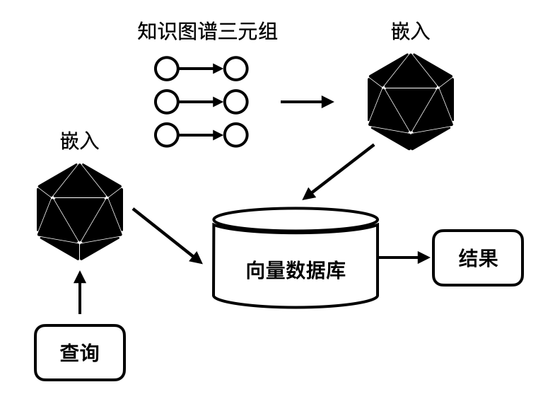
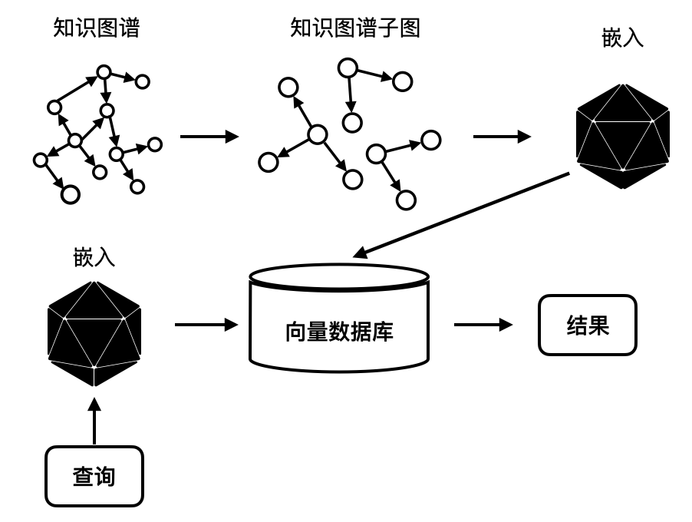
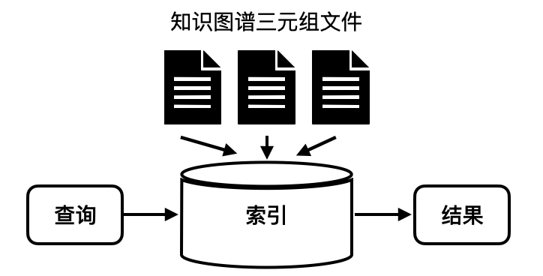
成果展示--Faiss on KG Subgraphs
以知识图谱子图作为检索单位的检索方法
Lucene on KG Triples
Faiss on KG Triples
Faiss on KG Subgraphs
Notes:
However, directly applying Transformer to modeling stock movements is problematic in two aspects. Firstly, the global self-attention focuses on point-wise token similarities without contextual insights. So the lack of pattern-wise interaction hinders the adequate discrimination of stock tendency and is susceptible to noise points. Secondly, the basic query-key matching paradigm is position agnostic. For example, in this figure, {A;B} reflects stock wave patterns in the context of long-term spans and {C;D} reflects short-term spans. The patterns C and D are closer than A and B, which means that their interaction is more responsible for observing high-frequency regularities. This inspires us to factor in the elapsed time between stock change patterns.

Slide 16
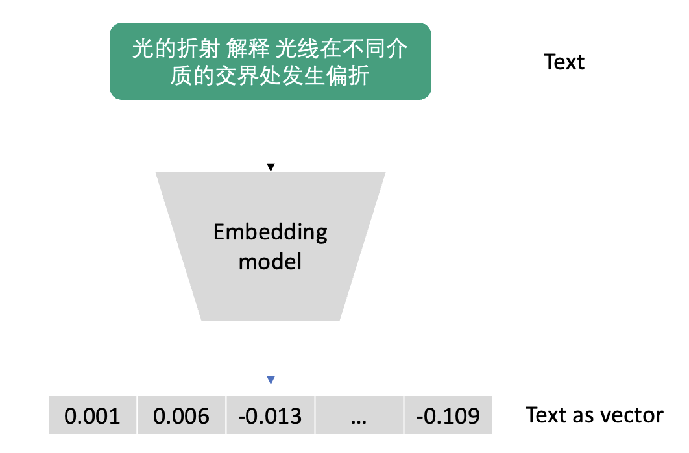
成果展示--Faiss on KG Subgraphs
具体步骤
1.将知识图谱三元组嵌入转为向量
2.进行基于DBSCAN算法的层次聚类知识图谱子图划分
3.基于知识图谱子图进行Faiss检索
Step1：Embedding
步骤一嵌入流程
Notes:
However, directly applying Transformer to modeling stock movements is problematic in two aspects. Firstly, the global self-attention focuses on point-wise token similarities without contextual insights. So the lack of pattern-wise interaction hinders the adequate discrimination of stock tendency and is susceptible to noise points. Secondly, the basic query-key matching paradigm is position agnostic. For example, in this figure, {A;B} reflects stock wave patterns in the context of long-term spans and {C;D} reflects short-term spans. The patterns C and D are closer than A and B, which means that their interaction is more responsible for observing high-frequency regularities. This inspires us to factor in the elapsed time between stock change patterns.

Slide 17
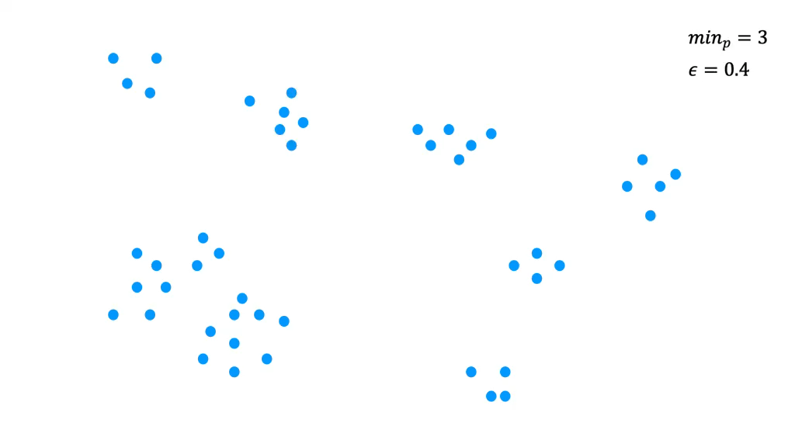
成果展示--Faiss on KG Subgraphs
Step2:子图划分
基于DBSCAN算法的层次聚类知识图谱子图划分算法
Notes:
However, directly applying Transformer to modeling stock movements is problematic in two aspects. Firstly, the global self-attention focuses on point-wise token similarities without contextual insights. So the lack of pattern-wise interaction hinders the adequate discrimination of stock tendency and is susceptible to noise points. Secondly, the basic query-key matching paradigm is position agnostic. For example, in this figure, {A;B} reflects stock wave patterns in the context of long-term spans and {C;D} reflects short-term spans. The patterns C and D are closer than A and B, which means that their interaction is more responsible for observing high-frequency regularities. This inspires us to factor in the elapsed time between stock change patterns.

Slide 18
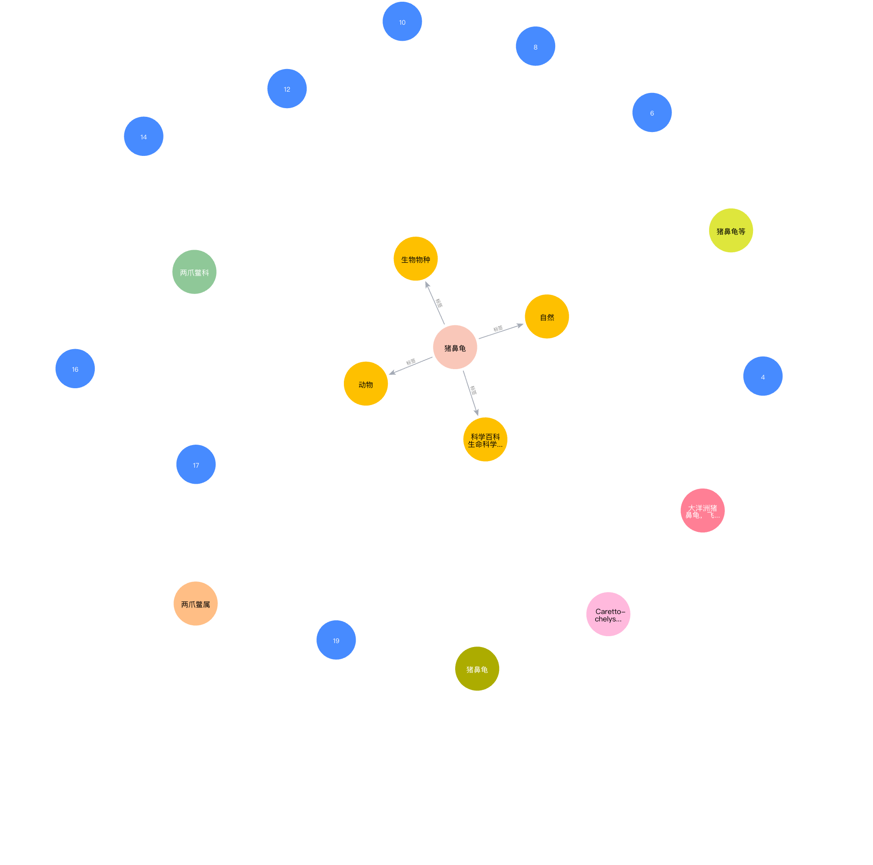
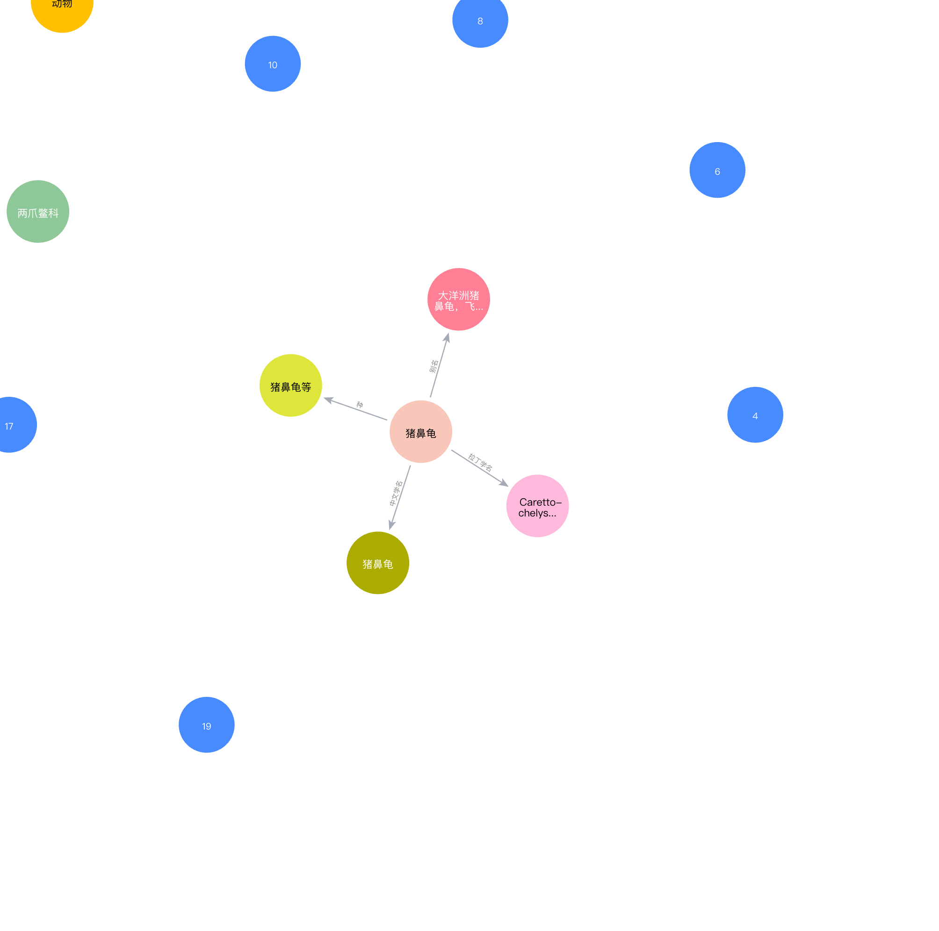
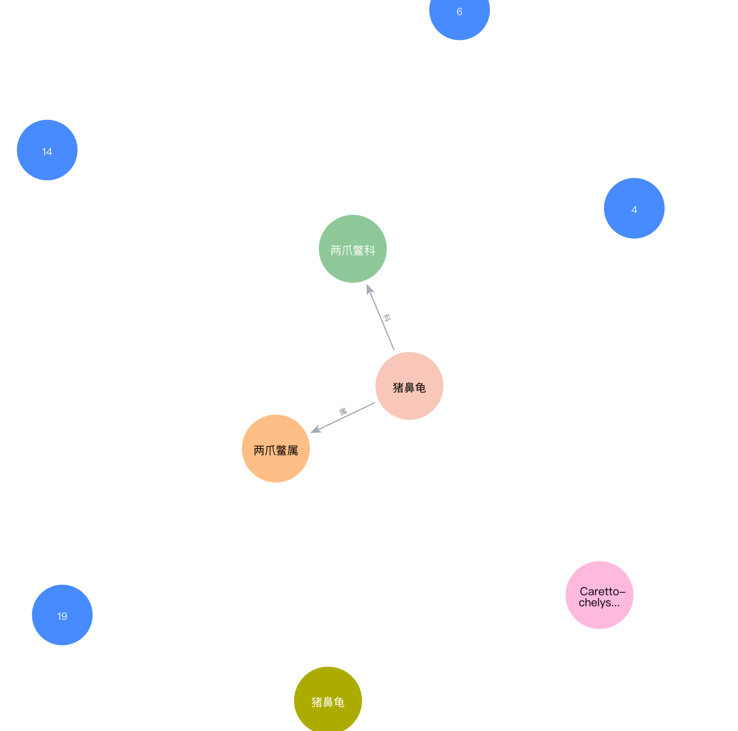
成果展示--Faiss on KG Subgraphs
Step3:基于知识图谱子图进行Faiss检索
1.将知识图谱子图进行嵌入
2.使用Faiss构建IndexFlatL2索引
3.将查询文本嵌入，将查询向量传递索引进行检索
4.将检索到的嵌入向量映射回原始知识图谱
Notes:
However, directly applying Transformer to modeling stock movements is problematic in two aspects. Firstly, the global self-attention focuses on point-wise token similarities without contextual insights. So the lack of pattern-wise interaction hinders the adequate discrimination of stock tendency and is susceptible to noise points. Secondly, the basic query-key matching paradigm is position agnostic. For example, in this figure, {A;B} reflects stock wave patterns in the context of long-term spans and {C;D} reflects short-term spans. The patterns C and D are closer than A and B, which means that their interaction is more responsible for observing high-frequency regularities. This inspires us to factor in the elapsed time between stock change patterns.

Slide 19
成果展示--领域基准测试
知识图谱与数据集构造
知识图谱
获取科学教育知识点名称5588个。
构造了一个包含100000条知识图谱三元组的科学教育知识图谱。
数据集
构造了包含50条与本文构建的科学教育知识图谱相关的自然问答对作为测试数据集。
Notes:
However, directly applying Transformer to modeling stock movements is problematic in two aspects. Firstly, the global self-attention focuses on point-wise token similarities without contextual insights. So the lack of pattern-wise interaction hinders the adequate discrimination of stock tendency and is susceptible to noise points. Secondly, the basic query-key matching paradigm is position agnostic. For example, in this figure, {A;B} reflects stock wave patterns in the context of long-term spans and {C;D} reflects short-term spans. The patterns C and D are closer than A and B, which means that their interaction is more responsible for observing high-frequency regularities. This inspires us to factor in the elapsed time between stock change patterns.

Slide 20
成果展示--领域基准测试
评价方法
选用忠实度(Faithfulness)、答案正确性(Answer Correctness)这两个评价指标。
忠实度
忠实度是用来衡量生成答案与检索得到的参考背景知识之间事实一致性的指标。
大模型生成答案包含的信息量有多少来自从检索捕获的信息量。
答案正确性
答案正确性涉及评估生成的答案与真实答案的准确性。答案正确性依赖于两个方面：生成答案的事实正确性和生成答案与真实答案之间的语义相似性。
Notes:
However, directly applying Transformer to modeling stock movements is problematic in two aspects. Firstly, the global self-attention focuses on point-wise token similarities without contextual insights. So the lack of pattern-wise interaction hinders the adequate discrimination of stock tendency and is susceptible to noise points. Secondly, the basic query-key matching paradigm is position agnostic. For example, in this figure, {A;B} reflects stock wave patterns in the context of long-term spans and {C;D} reflects short-term spans. The patterns C and D are closer than A and B, which means that their interaction is more responsible for observing high-frequency regularities. This inspires us to factor in the elapsed time between stock change patterns.

Slide 21
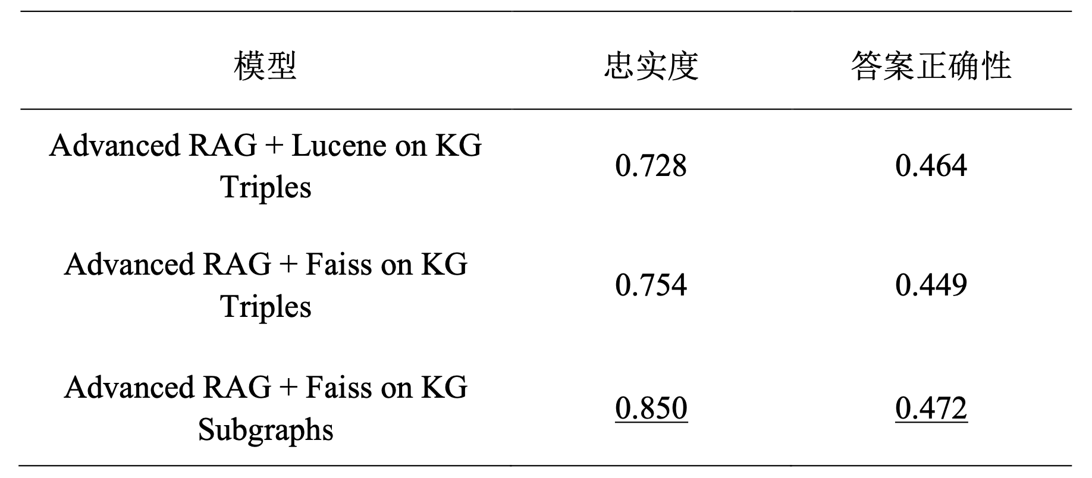
成果展示--领域基准测试
评价方法
实验一 以知识图谱子图作为检索单位的检索方法优越性对比
表5 实验一对照结果
Notes:
However, directly applying Transformer to modeling stock movements is problematic in two aspects. Firstly, the global self-attention focuses on point-wise token similarities without contextual insights. So the lack of pattern-wise interaction hinders the adequate discrimination of stock tendency and is susceptible to noise points. Secondly, the basic query-key matching paradigm is position agnostic. For example, in this figure, {A;B} reflects stock wave patterns in the context of long-term spans and {C;D} reflects short-term spans. The patterns C and D are closer than A and B, which means that their interaction is more responsible for observing high-frequency regularities. This inspires us to factor in the elapsed time between stock change patterns.

Slide 22
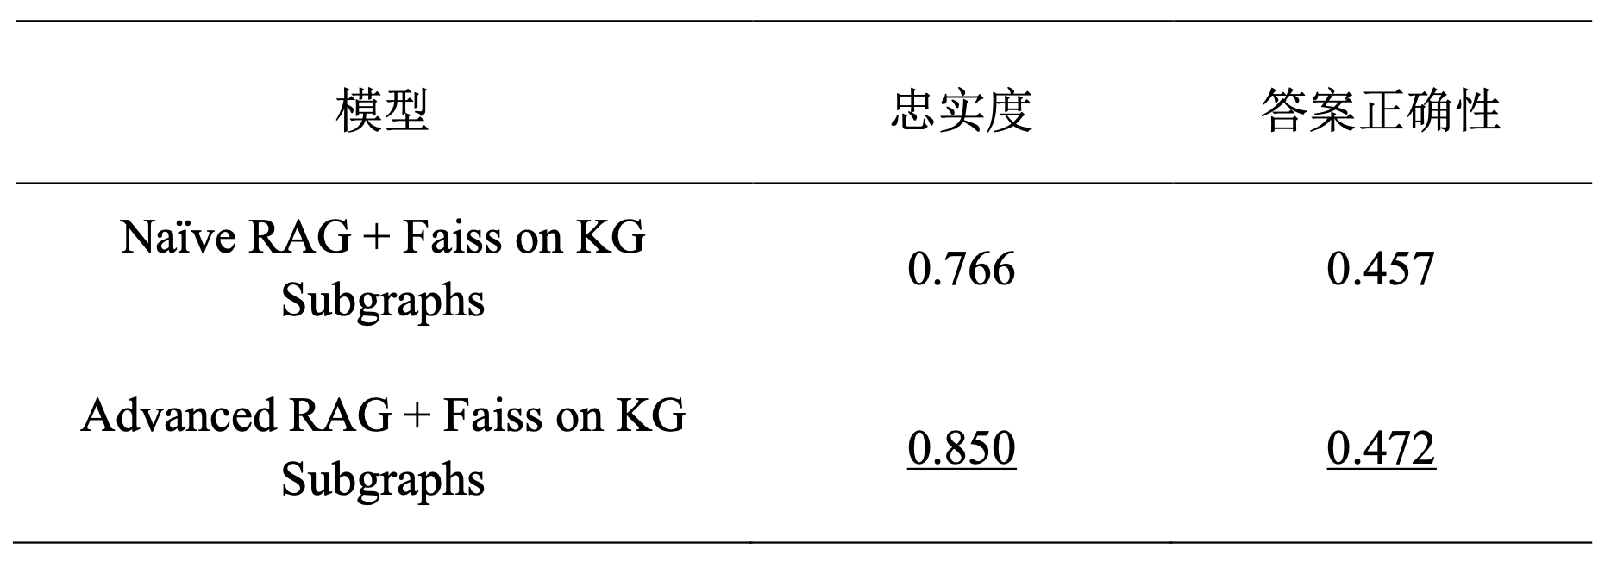
成果展示--领域基准测试
评价方法
实验二 优化检索增强生成框架优越性对比
表6 实验二对照结果
Notes:
However, directly applying Transformer to modeling stock movements is problematic in two aspects. Firstly, the global self-attention focuses on point-wise token similarities without contextual insights. So the lack of pattern-wise interaction hinders the adequate discrimination of stock tendency and is susceptible to noise points. Secondly, the basic query-key matching paradigm is position agnostic. For example, in this figure, {A;B} reflects stock wave patterns in the context of long-term spans and {C;D} reflects short-term spans. The patterns C and D are closer than A and B, which means that their interaction is more responsible for observing high-frequency regularities. This inspires us to factor in the elapsed time between stock change patterns.

Slide 23
后续计划
现存问题
RAG而非SFT：受限于SFT需要大量的计算和存储资源，特别是在面对大规模预训练模型时，微调过程可能需要极大的计算资源，这对于资源受限的环境来说是一个挑战。因此，在模型邻域增强方法中选择通过RAG来实现。
TechEdu KG的质量优先：在TechEdu KG构建中采用GLM-4+Prompt自动化构建，其中GLM-4 API的调用受到额度限制，这对自动化构建过程造成了一定的限制。每次生成的文本数据或关系的数量受到API调用次数的制约，导致我们在短期内无法大规模、快速地扩展知识图谱。
知识图谱合并补全：在自动化构建KG中GLM-4是基于文本片段生成的知识图谱，其中三元组的具体名称具有一定不确定性。E.g.(the force,r,t,c)---(force ,r,t,c)，这需要我们后续对碎片化的三元组进行合并与补全，目前采用的方式依然是人工修补。
Notes:
However, directly applying Transformer to modeling stock movements is problematic in two aspects. Firstly, the global self-attention focuses on point-wise token similarities without contextual insights. So the lack of pattern-wise interaction hinders the adequate discrimination of stock tendency and is susceptible to noise points. Secondly, the basic query-key matching paradigm is position agnostic. For example, in this figure, {A;B} reflects stock wave patterns in the context of long-term spans and {C;D} reflects short-term spans. The patterns C and D are closer than A and B, which means that their interaction is more responsible for observing high-frequency regularities. This inspires us to factor in the elapsed time between stock change patterns.

Slide 24
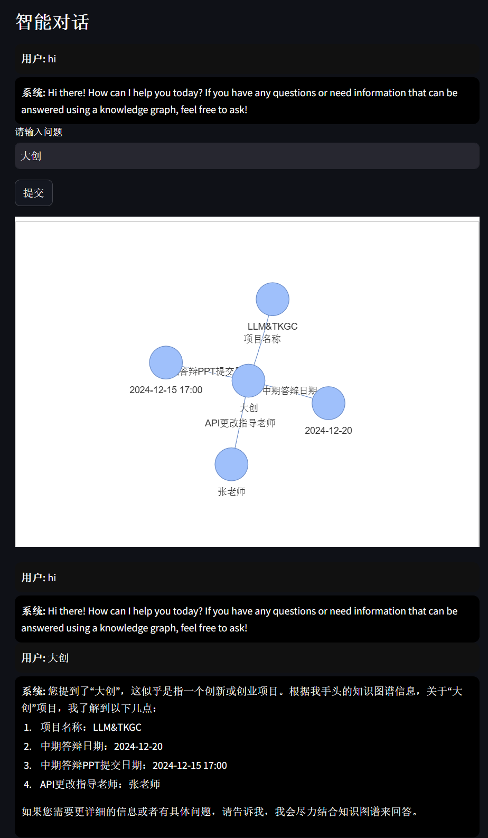
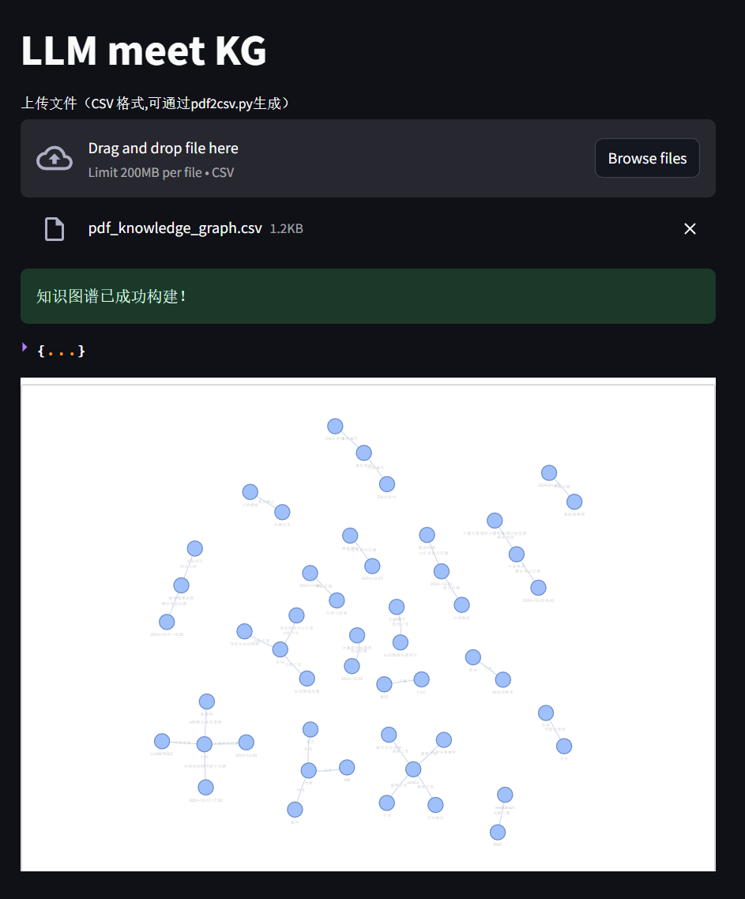
后续计划
Web界面美观和优化
Notes:
However, directly applying Transformer to modeling stock movements is problematic in two aspects. Firstly, the global self-attention focuses on point-wise token similarities without contextual insights. So the lack of pattern-wise interaction hinders the adequate discrimination of stock tendency and is susceptible to noise points. Secondly, the basic query-key matching paradigm is position agnostic. For example, in this figure, {A;B} reflects stock wave patterns in the context of long-term spans and {C;D} reflects short-term spans. The patterns C and D are closer than A and B, which means that their interaction is more responsible for observing high-frequency regularities. This inspires us to factor in the elapsed time between stock change patterns.

Slide 25
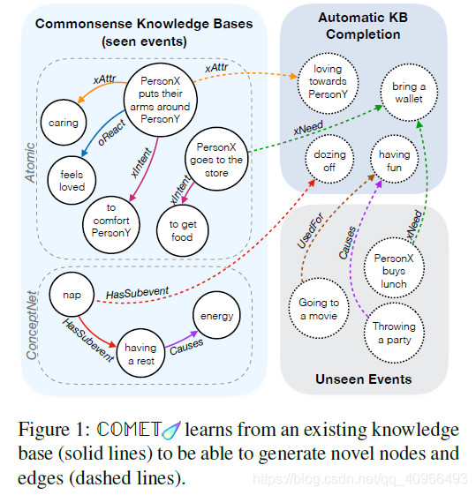
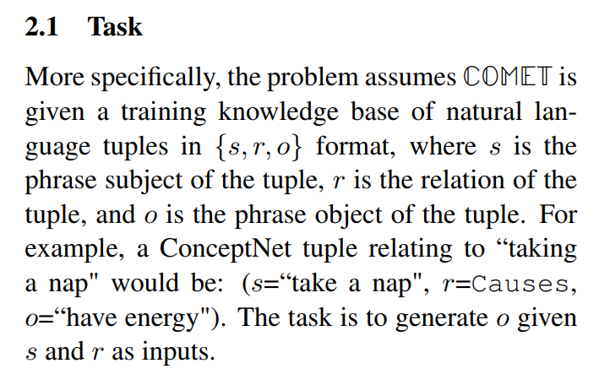
后续计划
使用COMET合并和补全KG
https://arxiv.org/pdf/1906.05317
Notes:
However, directly applying Transformer to modeling stock movements is problematic in two aspects. Firstly, the global self-attention focuses on point-wise token similarities without contextual insights. So the lack of pattern-wise interaction hinders the adequate discrimination of stock tendency and is susceptible to noise points. Secondly, the basic query-key matching paradigm is position agnostic. For example, in this figure, {A;B} reflects stock wave patterns in the context of long-term spans and {C;D} reflects short-term spans. The patterns C and D are closer than A and B, which means that their interaction is more responsible for observing high-frequency regularities. This inspires us to factor in the elapsed time between stock change patterns.

Slide 26
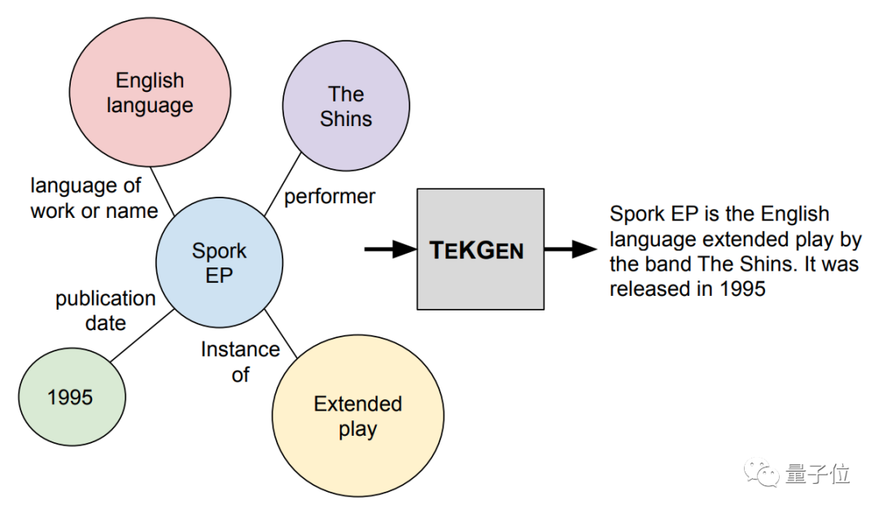
后续计划
邻域知识图谱的快速自动化构建
TEKGEN：Triple to Natural language
Maybe we can do the opposite
…
Notes:
However, directly applying Transformer to modeling stock movements is problematic in two aspects. Firstly, the global self-attention focuses on point-wise token similarities without contextual insights. So the lack of pattern-wise interaction hinders the adequate discrimination of stock tendency and is susceptible to noise points. Secondly, the basic query-key matching paradigm is position agnostic. For example, in this figure, {A;B} reflects stock wave patterns in the context of long-term spans and {C;D} reflects short-term spans. The patterns C and D are closer than A and B, which means that their interaction is more responsible for observing high-frequency regularities. This inspires us to factor in the elapsed time between stock change patterns.

Slide 27
Thank you!
Notes:
That concludes my talk for today. Thank you!

